Slide 1
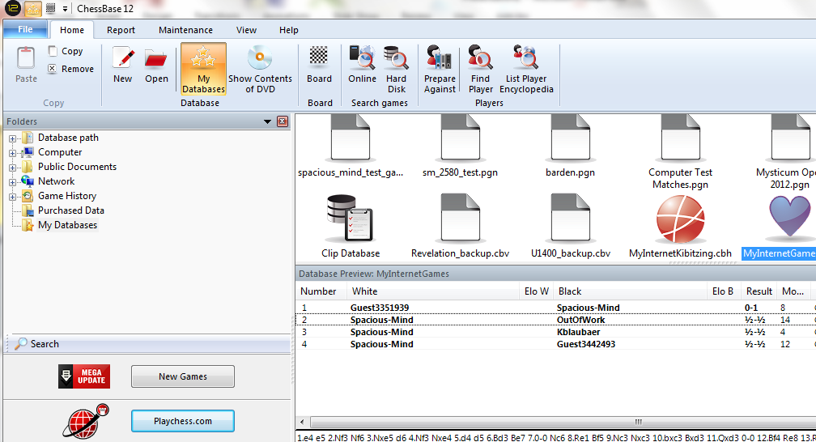
How to use the Playchess Chess Server
Click: Playchess.com
With Chessbase, you click on “Playchess.com” icon to log into Playchess.

Slide 2
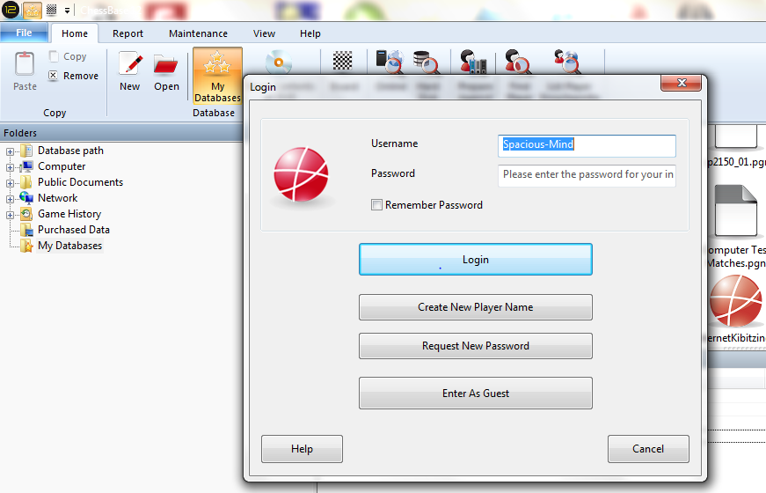
How to use the Playchess Chess Server
Click to:
Enter As Guest
If you are a guest, you click on “Enter As Guest”. You can also create your player name here, or enter as a Member using your Username and Password credentials.

Slide 3
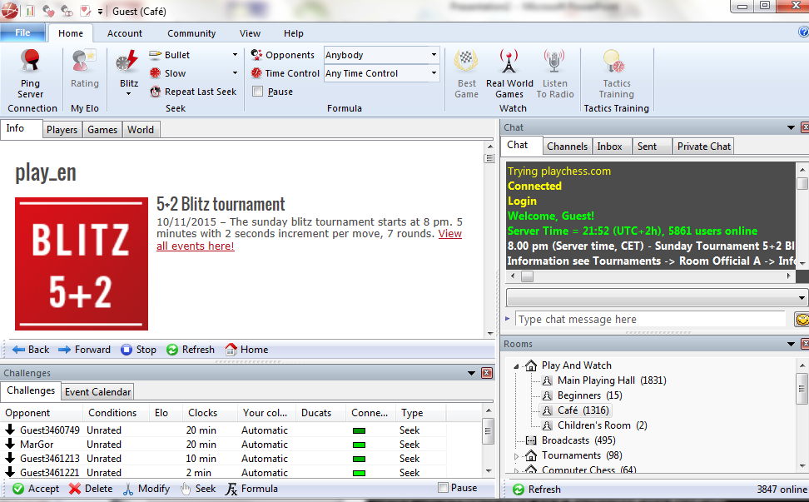
How to use the Playchess Chess Server
When Playchess has loaded you will see this screen. Now Familiarize yourself and get used to the screens and tabs by just clicking a few. When done, go back to the “Home” tab.

Slide 4
How to use the Playchess Chess Server
From the above dropdown options make sure you select:
Opponents: Anybody
Time Control: Any Time Control
Make sure you select the above settings. This is important as it allows you to receive the game invites that will be sent to you if your opponent challenges you..

Slide 5
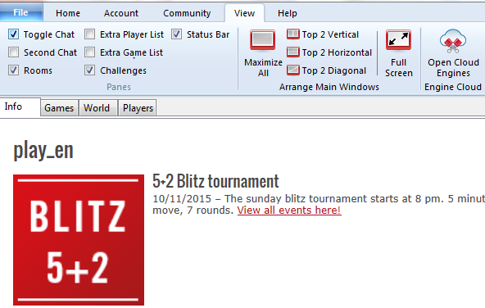
How to use the Playchess Chess Server
Click on:
View tab
Checkmark all the boxes exactly as shown above
Go to “View” tab and checkmark: Toggle Chat, Rooms, Challengers and Status Bar. When done, go back to “Home” tab.

Slide 6
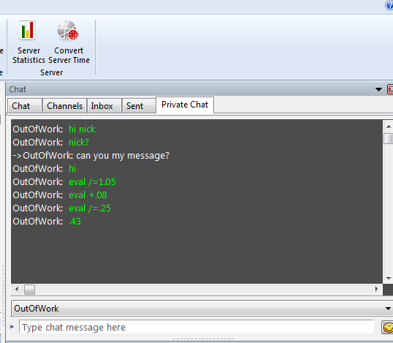
How to use the Playchess Chess Server
Here I am receiving eval updates. I was unregistered and therefore could not respond. But still useful if the registered Member sends his computer evaluations to you periodically, and vice-versa.
In the “Home” tab you will see a tab for chat. As a guest you can see the messages sent to you, but you cannot respond. You must be a fully registered member to be able to chat.

Slide 7
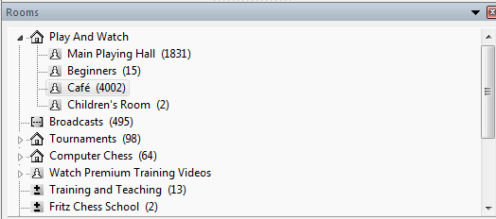
How to use the Playchess Chess Server
Our Tournament will be played in the “Café” room. Make sure you click on “Café” to enter. Your opponent will be here.
This is the Rooms tab. Here is where people hangout to play chess. We will be playing our Tournament in the “Café” room. Therefore click on “Café” to enter this room.

Slide 8
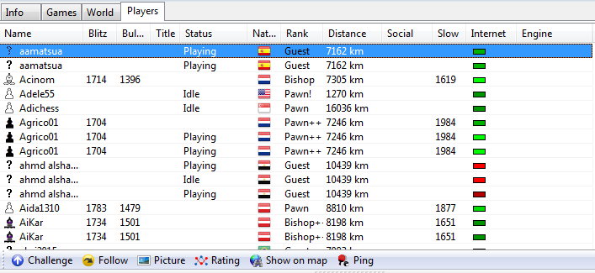
How to use the Playchess Chess Server
Click on “Name” to sort alphabetically.
Find your opponent by scrolling down the list.
Next go to the “Players” tab and find your opponent. You can do that by sorting the list alphabetically under “Name” and scrolling until you find your opponent.

Slide 9
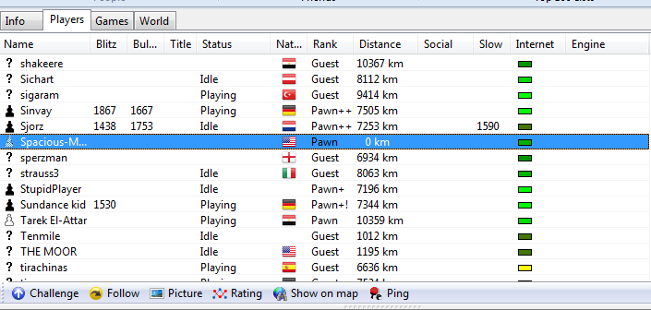
How to use the Playchess Chess Server
Highlight Opponent with your mouse and right-click with your mouse and scroll down to “Challenge”
When you have found your opponent, highlight him with your mouse and right-click on him with your mouse. A drop-down list will appear. Select “Challenge” from this list.

Slide 10
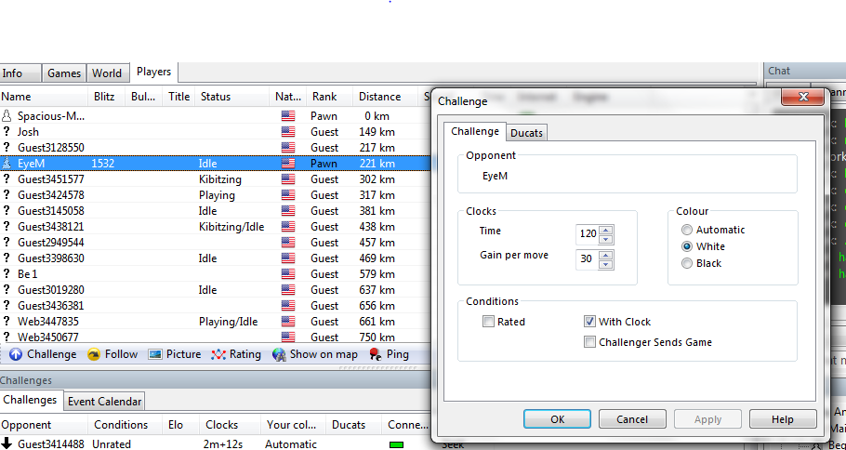
How to use the Playchess Chess Server
IMPORTANT!
We don’t want to lose on time when playing dedicated chess computer matches.
SELECT: 120 for “Time” & 30 for “Gain per Move”
Complete exactly the same as this!
If you have selected “Challenge”, a pop-up window will appear. Enter 120 for “Time”. Enter 30 for “Gains per move”. Enter your “Colour” and checkmark “With Clock”. (IMPORTANT! As we need sufficient time on the clocks so that Playchess does not arbitrate a win or loss if you run out of time).

Slide 11
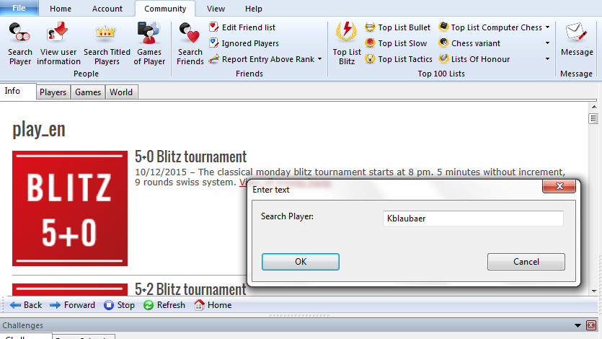
How to use the Playchess Chess Server
“Search Player” pop-up.
“Community” tab.
“Search Player” Icon.
If you can are a registered member then the “Search Player” icon is also available for you to search for your opponent which makes it easier. Once clicked a pop-up search window opens.

Slide 12
How to use the Playchess Chess Server
Challenge message is sent to your opponent!
In the “Challenges” tab your selected opponent’s name will appear and under the “Type” column you will see your request is “Outgoing”.

Slide 13
How to use the Playchess Chess Server
Blaubaer (Michael) inviting me to a game! ☺
Your opponent is sending you a challenge!
Double-click on the opponent to accept the challenge!
If your opponent is sending you a challenge then you will see “Incoming” under the “Type” Column. Double-click on your “Incoming” challenger to accept the challenge!

Slide 14
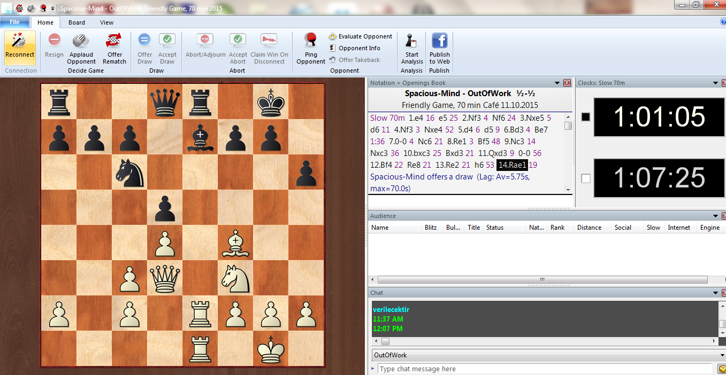
How to use the Playchess Chess Server
You are now ready to play! To play you pick up your piece and drop it into the square you want to move it to.
It is that easy!
A window will open with a Chessboard, Game list, Clocks, Audience area and Chat area. Chat area only works for registered member to chat.

Slide 15
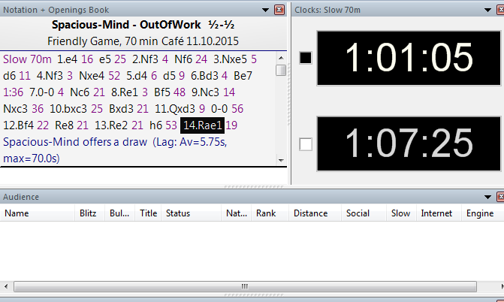
How to use the Playchess Chess Server
This is Nick!
This is Steve B.!
“Audience” window!
Players & Game information & move notation.
Clocks for both players.
If people come to support you, you will see them in the “Audience” window. Chess Clocks, Player Information and Move Notation is all here!

Slide 16
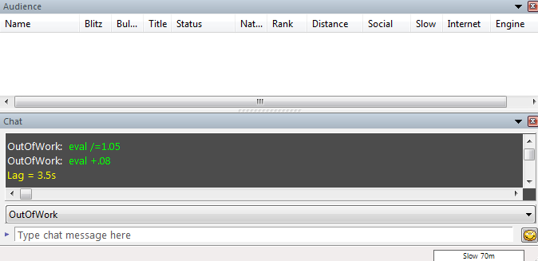
How to use the Playchess Chess Server
Chat messages you can send or receive (if registered)
That’s Steve messaging and pinging, trying to put me off my game!! ☺
You also have a “Chat” window here. Where you can if you are a registered member send information to your opponent or talk to him. If you are a Guest, then you can only view the messages but not send.

Slide 17
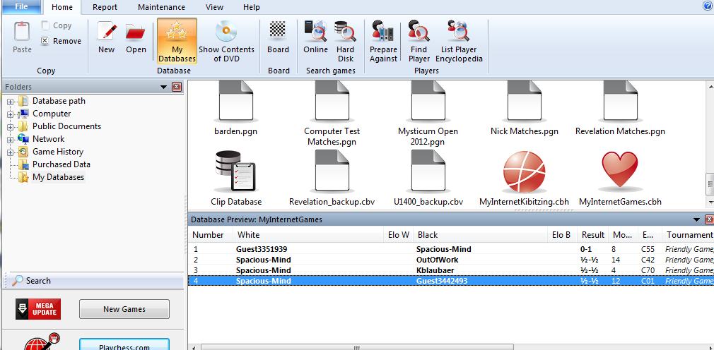
How to use the Playchess Chess Server
Playchess DB’s
Your games played in the Database!
When the game is over, it is saved automatically and you can replay it anytime out of your database, or copy it and paste it into a forum post!
That’s all folks!!!

Slide 18
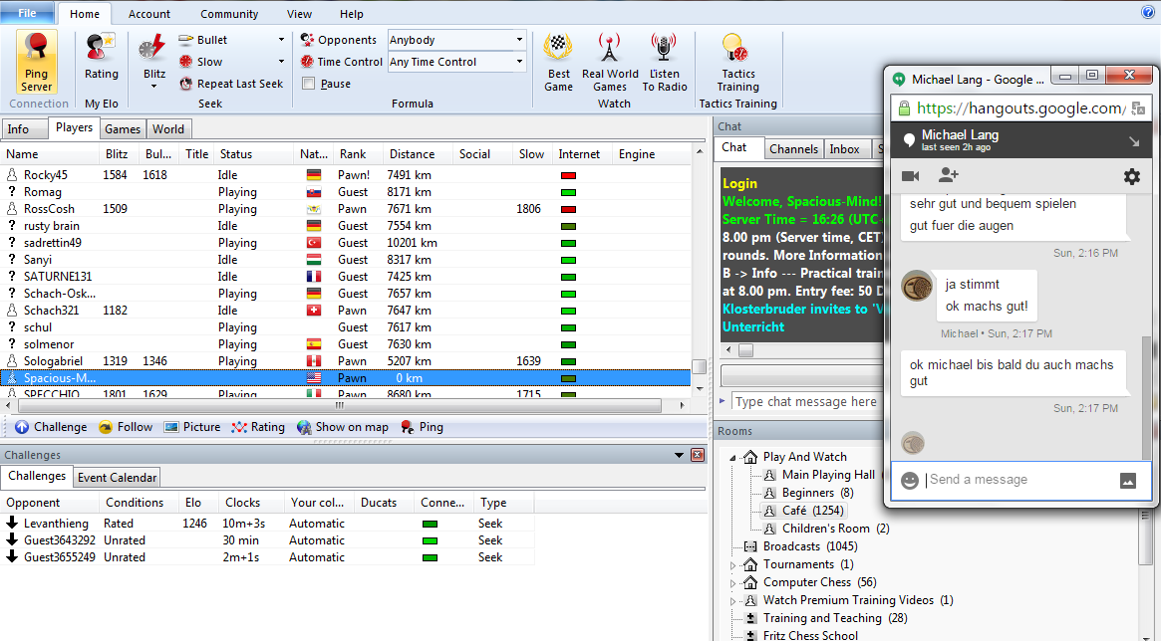
How to use the Playchess Chess Server
Michael and me talking while playing in Playchess!
Google Hangout Chat
Get “Google Hangouts” It will help you in case there is a problem or a crash as you can chat with your opponent and send him moves if necessary through “Google Hangouts” to allow you continue your game without aborting it. Open a free Google Gmail email account and “Google Hangouts” comes with it for free!

